Slide 1
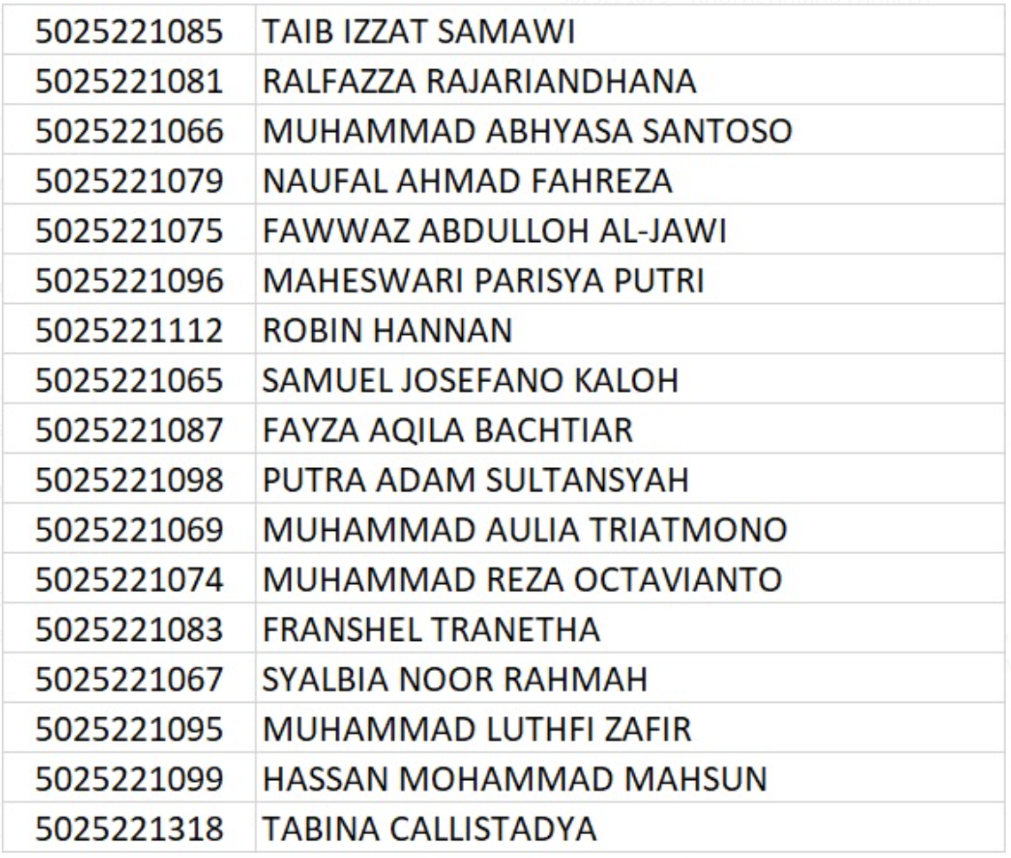
BISMILLAH SABAR PUASA ETS 😈
Those who highlighted with yellow color,
You must use queue (not dequeue) ☺ 😈
Please do using STL

Slide 2
Session 2- OMG
Batman wants to open a cave that contains superpowers There were a clue contains the commands to open the cave. Give a command “No Clue” as an answer. To make things easier the batman can use the command “Out” to take out the superpower that is placed on top and a command to count the clue called “Count them”, if the batman somehow take out the important Clue it will give an output “I'm going crazy, right?”, if the amount of clue is sufficient (Clue >= 5), print “He's the one that’s living in my system”, if the amount of clue is not enough, print “They keep on asking me, "Who is he?"
Batman wants to get another super power (speed = 10, money = 15, strength = 20) from the cave, But he must do the magic words to open up the cave and get the superpower. To do that, batman tries using his word that has been collected from a while ago. Commands of magic words:
Out: it will pop the superpower inside of cave if the data = clue the output will (I'm going stronger, right?) if it is not clue print nothing.
Count them : to count how many clue inside of the cave and also print with the rest of clue inside the cave. If it is more than or equal to 5 print (I got my super power back, x) if no print (I want more, this is not enough, x),
In the last output will be print out
the total points of super powers.
Sampel Input 0
7
Clue strength
Clue speed
Clue money
Not clue
Clue money
Not clue
Clue speed
4
Count them
Out
Out
Count them
Sampel Output 0
I got my super power back, 5: 2 speed,
2 money, 1 strength
I'm going stronger, right?
I want more, this is not enough, 4: 1 speed,
2 money, 1 strength
I got 60 super power point
Input Format
The first line consists of N total input of data
Next Line is the amount of commands will be
instructed by the Batman defined by M
Constraint
The input could consist of whitespace (“ “)
Ex. Do not change Not clue to Not_clue

